Slide 1
ITMS 448 Cyber Security Techs
April 25, 2016
Individual Project: FileZilla Server
Hong Zhang

Slide 2
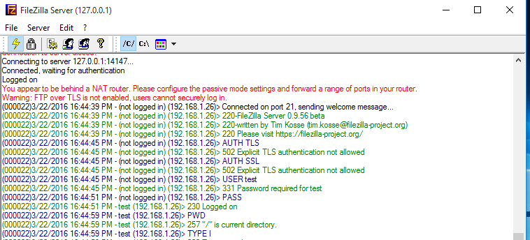
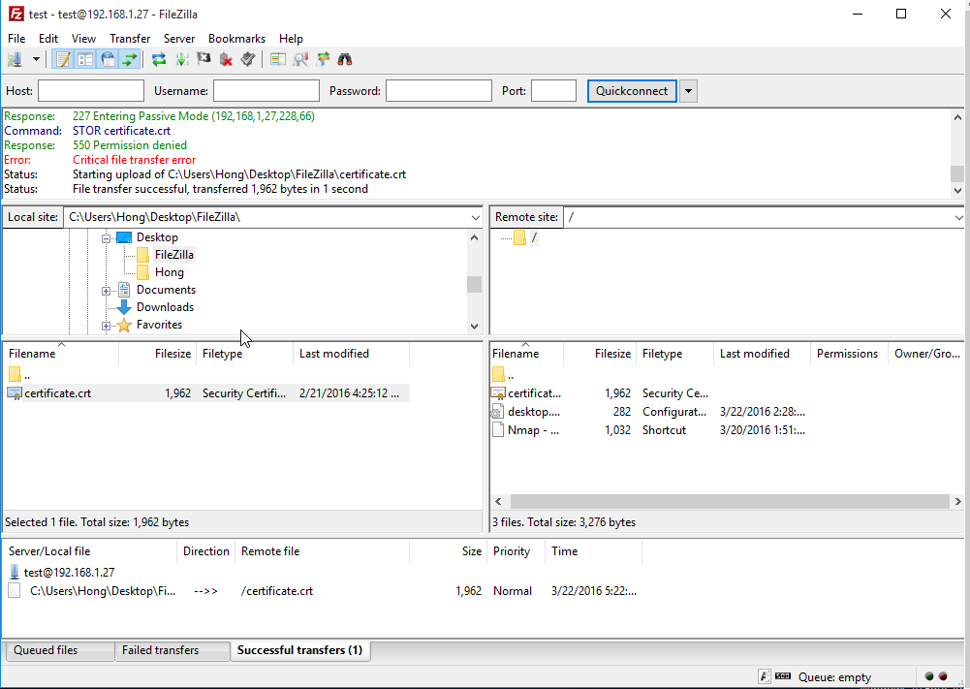
Individual Project: FileZilla Server
FTP (File Transfer Protocol) is a way for you to access, download and upload files to web server. Generally, users need to login when they use FTP to share or transfer files. Each user is given specific privilege what they can do (i.e. read access, would let you to view files only, read/write access allows you to read, and write/upload/modify files etc.) You can access FTP via a web browser, command line, or other software application.
FileZilla is a type of FTP and an open-source software. It includes FileZilla server which is a FTP server and FileZilla client to upload or download files.

Slide 3
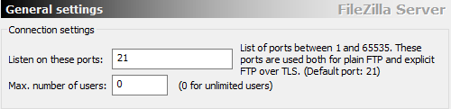
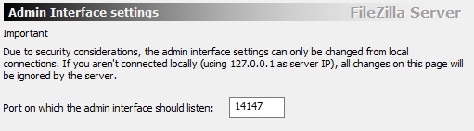
Individual Project: FileZilla Server
Default configurations for FileZilla server:
The default mode setting is port mode and the default Listen on port is 21. The default port which is the admin interface of FileZilla Server is 14147.

Slide 4
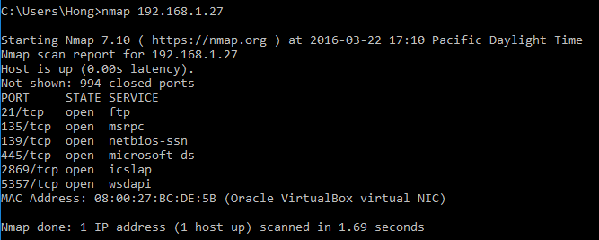
Individual Project: FileZilla Server
Default configurations for FileZilla server:
The default mode setting is port mode and the default Listen on port is 21. The default port which is the admin interface of FileZilla Server is 14147.
How to led to a vulnerability?

Slide 5
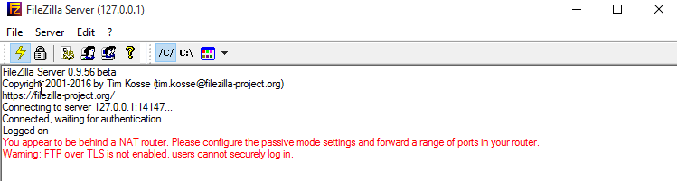
Individual Project: FileZilla Server
Default configurations for FileZilla server:
In the managing menu, the default welcome message will shows the FileZilla Server version.

Slide 6
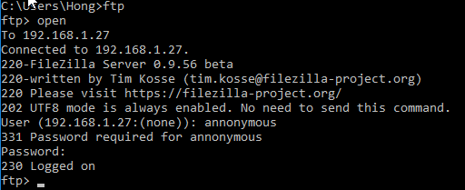
Individual Project: FileZilla Server
Default configurations for FileZilla server:
In the managing menu, the default welcome message will shows the FileZilla Server version.
How to led to a vulnerability?

Slide 7
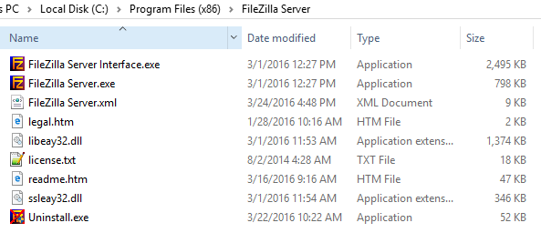
Individual Project: FileZilla Server
Default configurations for FileZilla server:
The default installation directory is c:\Program Files (x86)\FileZilla Server. In this installations folder, there are FileZilla application and a XML document which is plaintext and includes all users information.

Slide 8
Individual Project: FileZilla Server
The scenario of a possible attack against the FileZilla server with default configurations:
This server has two users which all use C drive as the sharing folder.
1. This user is an administrative user and has all privileges, can read, write/upload/modify files.
Username: test
Password: 12345678
2. This user has a guest account and only has the privilege to read file. We design it as an anonymous user used for public access (browsing) to your web Site. Usually, most FTP server has this kind of anonymous account to the public. Sometimes, this account has no password.
Username: anonymous
Password:

Slide 9
Individual Project: FileZilla Server
My attack can be divided into four steps:
Find FTP
Find the username and crack the password
Connect with the FileZilla server, find the installation folder
Get or change the privileges
Database Security: Figure 10-1 The process of intrusion

Slide 10
Individual Project: FileZilla Server
Video URL:
http://www.screencast.com/t/FbNjyX8wazw

Slide 11
Individual Project: FileZilla Server
Harden FileZilla Server:
Change the default port number
Use complicated password
Encrypt the configuration XML file and have no privilege to read or write
Change the welcome message, such as “Welcome to Server-U FTP Server”
Change the default installation directory
Disable Anonymous Access
Use SSL/TSL and choose “Force SSL for user login”
Use Logon Time Restrictions
Restrict Access by IP
Audit Logon Events
Enable Account Lockout and Account Lockout Threshold

Slide 12
Individual Project: FileZilla Server
Bibliography
Basta, Alfred & Melissa Zgola, Database Security, 1st Ed. Cengage Learning 2011

